Slide 1
Adya Puta

Slide 2
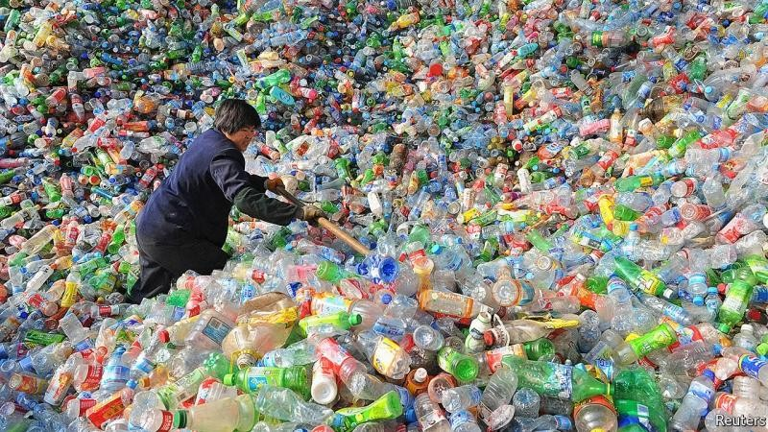
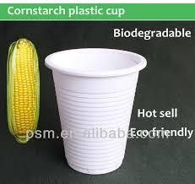
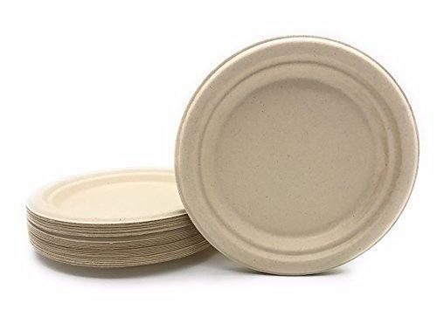
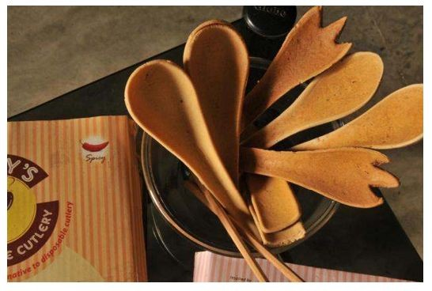
Plastics in food and beverage packing….
Biodegradable Plastics
But These Biodegradable plastics require land to grow their raw materials…..
No Introduction needed for this Curse of the Earth.

Slide 3
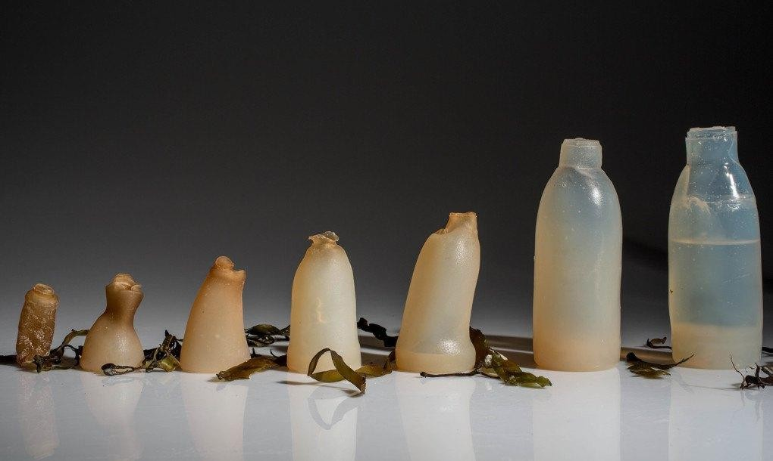
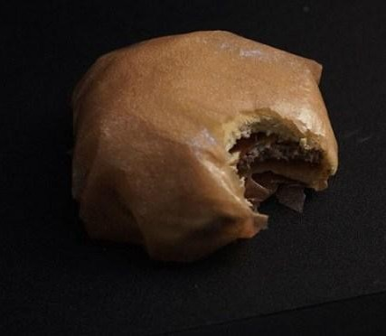
Disposable Plastics made using Seaweed
These disposable packings are degradable in 5-6 weeks.
They dissolve in warm water.
They are tasteless,ordourless.
S EAW EEDS
Seaweeds grow at a rate of 40 tonnes per hectare annually.
“What if you can eat your burger without unwrapping it…” Interesting right..!

Slide 4
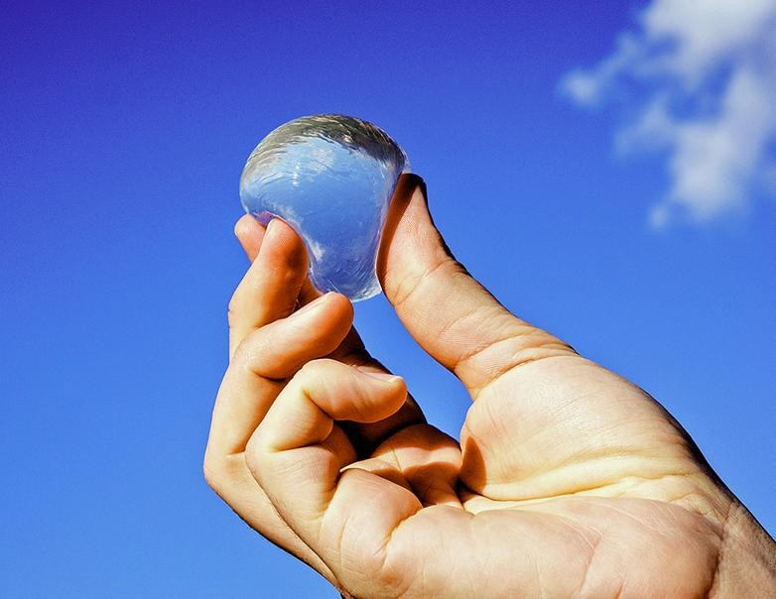
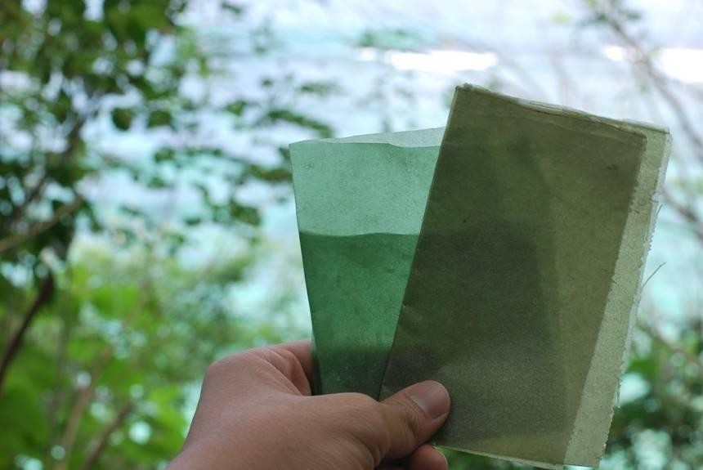
Experimentation and Study
Skipping rocks technology from London created tiny water bottles using seaweed.
Evoware a company in Indonesia has created packets,tea bags,etc.

Slide 5
How Our Business works...
Pilot Project
An Eﬀective Small scale production in best suitable locations.
Collaboration
Bring seaweeds cultivators under one roof.
Large Scale production
Will start a large scale production by the result and experiences from pilot project.
MARKET
Cafetarias,institutions
.
Food delivery companies,Restaurants
Food and beverage manufacturers.

Slide 6

The Team
“We took too much, we want to give it back..”

